Slide 1
Business Intelligence
Prepared By
Dr.A.DEVI
Associate Professor
Department of Computer Applications

Slide 2
BI(Business Intelligence) is a set of processes, architectures, and technologies that convert raw data into meaningful information that drives profitable business actions. It is a suite of software and services to transform data into actionable intelligence and knowledge. BI has a direct impact on organization’s strategic, tactical and operational business decisions. BI supports fact-based decision making using historical data rather than assumptions and gut feeling. BI tools perform data analysis and create reports, summaries, dashboards, maps, graphs, and charts to provide users with detailed intelligence about the nature of the business.
Business Intelligence

Slide 3
Measurement: creating KPI (Key Performance Indicators) based on historic data Identify and set benchmarks for varied processes. BI systems organizations can identify market trends and spot business problems that need to be addressed. BI helps on data visualization that enhances the data quality and thereby the quality of decision making. BI systems can be used not just by enterprises but SME (Small and Medium Enterprises)
Why is BI important?

Slide 4
Step 1) Raw Data from corporate databases is extracted. The data could be spread across multiple systems heterogeneous systems. Step 2) The data is cleaned and transformed into the data warehouse. The table can be linked, and data cubes are formed. Step 3) Using BI system the user can ask quires, request ad-hoc reports or conduct any other analysis.
How Business Intelligence systems are implemented?

Slide 5
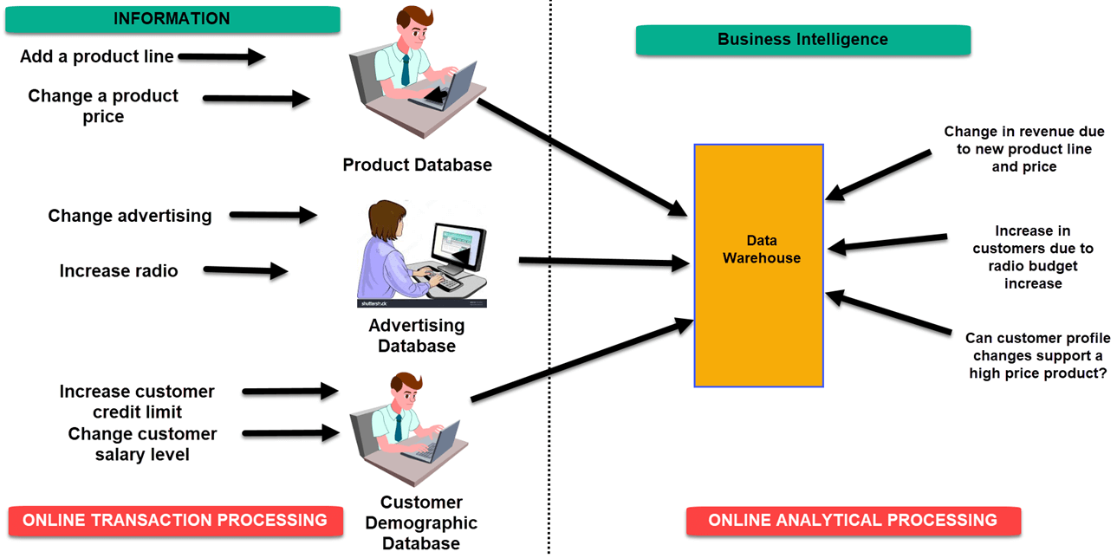
Examples of Business Intelligence System used in Practice

Slide 6
In an Online Transaction Processing (OLTP) system information that could be fed into product database could be add a product line change a product price. In an advertising database of OLTP system query that could be executed Changed in advertisement options Increase radio budget In OLTP system dealing with customer demographic data bases data that could be fed would be increase customer credit limit change in customer salary level

Slide 7
Four types of BI users
1. The Professional Data Analyst:
The data analyst is a statistician who always needs to drill deep down into data. BI system helps them to get fresh insights to develop unique business strategies.
2. The IT users:
The IT user also plays a dominant role in maintaining the BI infrastructure.
3. The head of the company:
CEO or CXO can increase the profit of their business by improving operational efficiency in their business.
4. The Business Users”
Business intelligence users can be found from across the organization. There are mainly two types of business users
Casual business intelligence user
The power user.

Slide 8
Advantages of Business Intelligence
1. Boost productivity
With a BI program, It is possible for businesses to create reports with a single click thus saves lots of time and resources. It also allows employees to be more productive on their tasks.
2. To improve visibility
BI also helps to improve the visibility of these processes and make it possible to identify any areas which need attention.
3. Fix Accountability
BI system assigns accountability in the organization as there must be someone who should own accountability and ownership for the organization’s performance against its set goals.

Slide 9
Advantages of Business Intelligence
4. It gives a bird’s eye view:
BI system also helps organizations as decision makers get an overall bird’s eye view through typical BI features like dashboards and scorecards.
5. It streamlines business processes:
BI takes out all complexity associated with business processes. It also automates analytics by offering predictive analysis, computer modeling, benchmarking and other methodologies.
6. It allows for easy analytics.
BI software has democratized its usage, allowing even nontechnical or non-analysts users to collect and process data quickly. This also allows putting the power of analytics from the hand’s many people.

Slide 10
BI System Disadvantages
1. Cost:
Business intelligence can prove costly for small as well as for medium-sized enterprises. The use of such type of system may be expensive for routine business transactions.
2. Complexity:
Another drawback of BI is its complexity in implementation of datawarehouse. It can be so complex that it can make business techniques rigid to deal with.
3. Limited use
Like all improved technologies, BI was first established keeping in consideration the buying competence of rich firms. Therefore, BI system is yet not affordable for many small and medium size companies.
4. Time Consuming Implementation
It takes almost one and half year for data warehousing system to be completely implemented. Therefore, it is a time-consuming process.

Slide 11
Trends in Business Intelligence
Artificial Intelligence:
AI and machine learning now take on complex tasks done by human intelligence. This capability is being leveraged to come up with real-time data analysis and dashboard reporting.
Collaborative BI:
BI software combined with collaboration tools, including social media, and other latest technologies enhance the working and sharing by teams for collaborative decision making.
Embedded BI:
Embedded BI allows the integration of BI software or some of its features into another business application for enhancing and extending it’s reporting functionality.
Cloud Analytics:
BI applications will be soon offered in the cloud, and more businesses will be shifting to this technology. As per their predictions within a couple of years, the spending on cloud-based analytics will grow 4.5 times faster.

